Slide 1
SMILIN’ THROUGH
enrollment during 2020-2021 (COVID)?
If your electric car runs out of power on the Interstate, do you walk to a charging station to get a bucket of electricity?
The first five days after the weekend are the toughest!
Sometimes I spend the whole meeting wondering how they got the big meeting table thru the door.
One minute, you’re young and fun. The next, you’re turning down the car stereo to see better.
I put my scale in the bathroom corner and that’s where the little liar will stay until it apologizes.
At my funeral, take the bouquet off my coffin and throw it into the crowd to see who is next.
Notes:
Describe business rules for using each – what are the non-negotiables in terms of design, etc.?
Describe logo usage – when to use KSDE, when to use Kansans Can, using dual logos, etc.

Slide 2
ANTI-MOTIVATIONAL QUOTES
enrollment during 2020-2021 (COVID)?
Never put off tomorrow what you can do the day AFTER tomorrow.
Make sure to drink enough water to stay hydrated while you suffer.
It’s never too late to give up.
The light at the end of the tunnel might be an oncoming train.
Don’t follow your friends off a bridge; lead them.
Do not take life too seriously. You will never get out of it alive.
Notes:
Describe business rules for using each – what are the non-negotiables in terms of design, etc.?
Describe logo usage – when to use KSDE, when to use Kansans Can, using dual logos, etc.

Slide 3
Journey Beyond Your Data
Dale Brungardt, Director
Sara McCullah, Assistant Director

Slide 4
Journey Beyond Your Data
Disclaimer: We will collect your data and we will use YOUR data for LOTS of reasons.

Slide 5
Journey Beyond Your Data
Data Collections
School Finance – Budget Packet
Timelines for KSDE Reports, KIDS & MIS Collections

Slide 6
Journey Beyond Your Data
Data Collections – June 1 SPED Pmt
Medicaid Claims (March 1)
Special Education Catastrophic and NPE (Due April 30)
Special Education Personnel Report
(Due May 1)
Special Education Transportation – Form 308 (Due May 10)

Slide 7
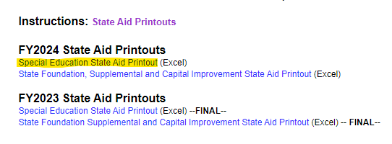
Journey Beyond Your Data
School Finance - Payment Information

Slide 8
Journey Beyond Your Data
School Finance - Payment Information
SPED Payment
General Fund Budget
Supplemental General Fund Budget (maybe)

Slide 9
Journey Beyond Your Data
Fiscal Data Collections
USD Budget
Interlocal Budget
Schools for Deaf/Blind Budget
ESSA Building Expenditures
Other Reports
18 Annual Statistical Report
ESSER Quarterly Report
Etc.

Slide 10
Journey Beyond Your Data
Fiscal Data – Revenues and Expenditures
Federal Reports
NPEFS (National Public Education Financial Survey) - - State Level
F33 (Census Bureau) - - District Level
SLFS (School Level Finance Survey) – Building Level Coming Soon

Slide 11
Journey Beyond Your Data
Fiscal Data – Revenues and Expenditures
State Reports
Building Report Card
Data Central
Data Requests
Legislators
Patrons
School Board Members

Slide 12
Journey Beyond Your Data
Non-Fiscal Data
Federal Reports (EdFacts)
State Reports
Data Requests
Directory Data
Grades Offered Data
Membership (gender/ethnicity/race)
Free or Reduced Lunch Status
Etc

Slide 13
A Day In The Life of Your Budget Data
USD / Interlocal Budget
1. Prepare/Submit to KSDE
2. Validations Check by KSDE
a. Negative Expenditures
b. Negative “Budgeted” Cash Balances
c. Invalid Data (non-numeric)

Slide 14
Validations
Notes:
All in all, I recall only having two budgets with issues on their Code 99. Fortunately, the published amounts were correct, but something changed after to result in their budget not matching what was published.

Slide 15
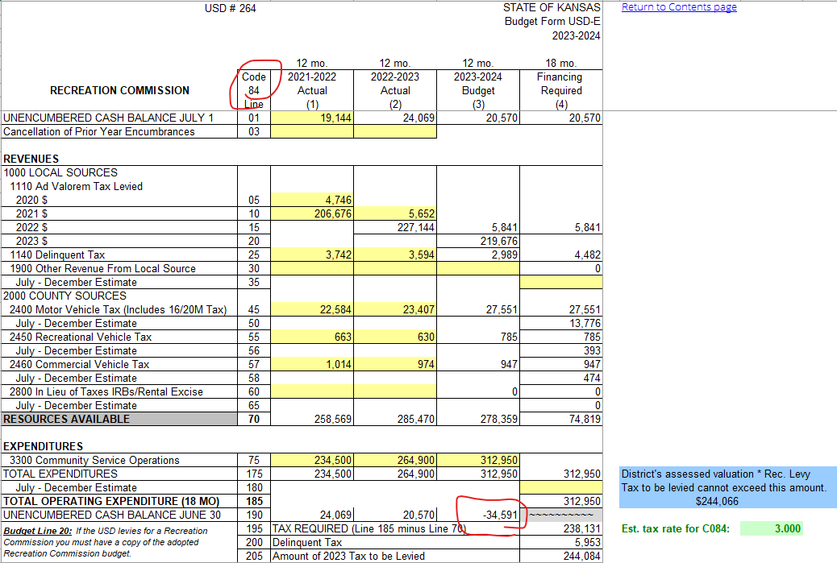
Validations

Slide 16
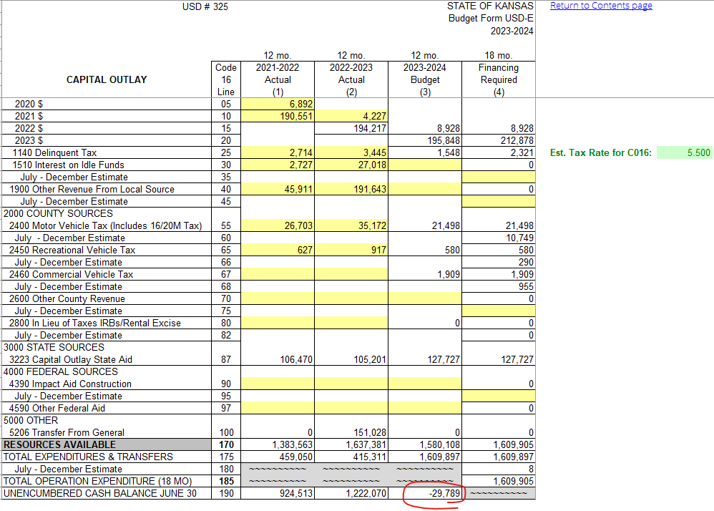
Validations

Slide 17
A Day In The Life of Your Budget Data
USD / Interlocal Budget
3. Load to Database
4. Publish to Data Central
a. Raw Data (CPFS)
b. Standard Reports
c. PDF Budget Documents

Slide 18
DATA CENTRAL https://datacentral.ksde.org/

Slide 19
DATA CENTRAL https://datacentral.ksde.org/

Slide 20
DATA CENTRAL USD Budget Documents

Slide 21
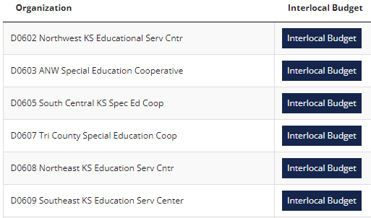
DATA CENTRAL Interlocal Budget Documents

Slide 22
DATA CENTRAL – CPFS

Slide 23
DATA CENTRAL Financial Accountability (KSA 72-5171)
Financial Accountability Report
– State Totals
– Report Summary

Slide 24
DATA CENTRAL – School Finance Reports Warehouse
School Finance Reports Warehouse
Cash Balances
Expenditures (Current Operating
Expenditures (Per Pupil)
Expenditures (Totals)
Mill Rates
Personnel (Licensed and Non-Licensed)
Salary (Teacher, Principal, Superintendent)
Pupil Teacher Ratio
Transportation Data

Slide 25
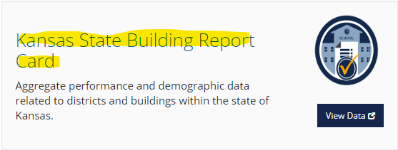
DATA CENTRAL https://datacentral.ksde.org/

Slide 26
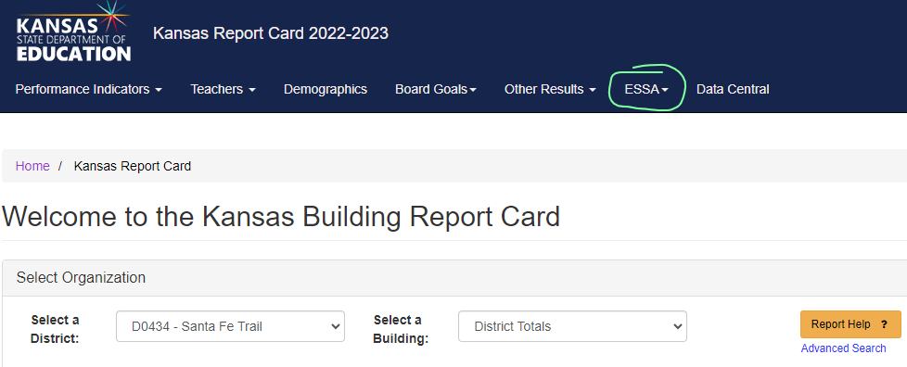
DATA CENTRAL Kansas State Building Report Card
ESSA Building Expenditures

Slide 27
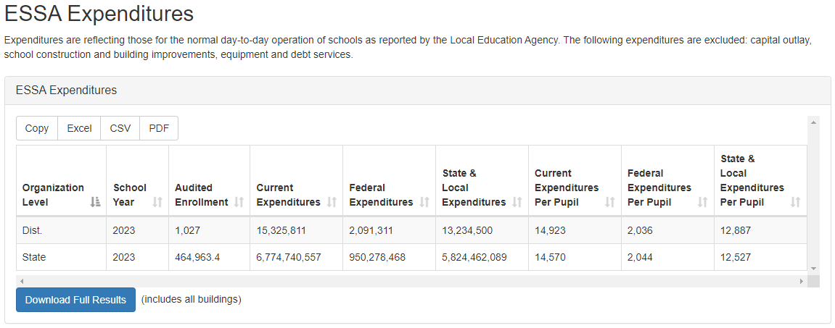
DATA CENTRAL

Slide 28
Sara McCullah Assistant Director School Finance (785) 296-4972 smccullah@ksde.org
Dale Brungardt Director School Finance (785) 296-3872 dbrungardt@ksde.org
Notes:
Our business cards will stand out as innovative and memorable with a vertical or portrait orientation. Bonus it has a back side!
a portrait or vertical design. It’s also two-sided!
Another fundamental change you may notice (if not you will after I tell you) is that the main address for our agency has been simplified to the main desk in Suite 102. As all our mail is sorted in the print shop having everything labeled by a different team name and suite only made sense to us as we're used to it. It is less confusing and complex for those we serve.

